Slide 1
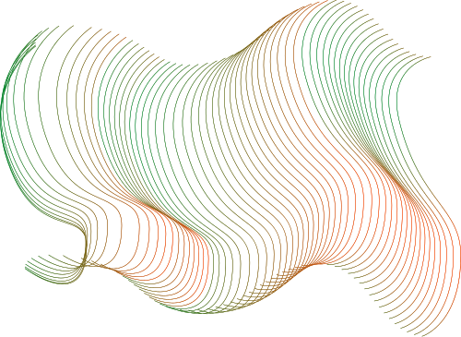

AI DJ: Spotify Hit Predictor
Presented by :
Antoine Paulis
Charlotte Michon
Mohamed-Khalil Ankri

Slide 2
Presentation Outline
Project Definition & Scoping
MLOps Automation
Data Strategy: EDA
Machine learning models
2

Slide 3
Project Definition & Scoping
Project proposal : Tool to predict if a song will be a “hit” or a “flop”, by training on a Spotify dataset of different genres of music.
Project value proposition :
Marketing goal : choose which titles could have the biggest impact to resonate with the audience of an ads
Radio diffusion : identify potential hits that could match current trends
DJ performance : choose best combinations of songs to animate parties
Independent artists : test different versions or mix of a track, to see which one could corresponds the best to actual “market” standards
retaken from project card we submitted
3

Slide 4
Project Definition & Scoping
Scope :
Data: Spotify audio features
Model: Binary classification (Hit vs. Flop) based on popularity thresholds
System: A functional API and a web dashboard
( Out of scope: Raw audio files (.mp3) or analyzing song lyrics (NLP) )
4

Slide 5
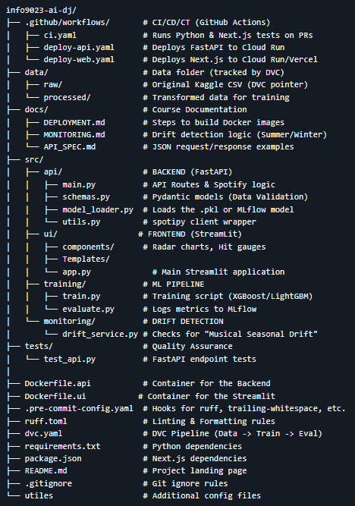
MLOps Automation
github repository :
For this milestone, we used the folders as following
docs: contains .md files with written explainations about the project, and .pdf figures generated (from the notebook EDA)
infra: contains the notebook for Google Cloud Storage implementation - mainly lab2 work, examples but we only fetch the bucket link to use the dataset to perform EDA (no uploaded file for the moment)
src: contains .py code files and notebook - the models are in training folder, other files are empty (just to represent desired structure for future work)
tests: contains python code too, mainly for lab sessions
git flow strategy :
merge approach to integrate changes from develop to features
no merge conflicts occured (only some local problems on synchronization for one of us)
screenshot picture to illustrate the initial repository structure: small modifications occured during work, but main idea for structure is still the same
5

Slide 6

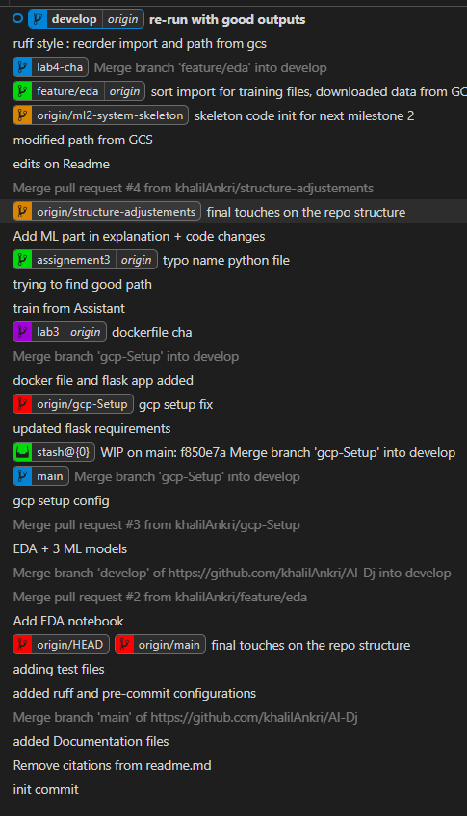
MLOps Automation
points of amelioration:
By observing the graph of our github, we want to improve...
merge earlier branches to avoid “crossed-nodes”: reduce live time of features branches and merge them as soon as one task is finished (or at least sketched completly - and bring some modifications and improvements later on)
delete remote/local branches earlier, and feature branches implemented only for the lab session: clean more frequently branches since it is not totally clear what changes were made exactly
maintain clearer history: consider less merge commits and use rebase to integrate more often our develop functionnalites (that we discussed together to assess utility)
6
generated git graph in VSCode

Slide 7
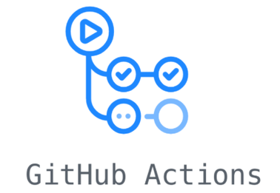

MLOps Automation
CI/CD Pipeline: Automated testing (future work), Docker builds (next milestone assignement), and deployments via GitHub Actions (workflow for next milestones).
Cloud Data Management: Utilizing a Google Cloud Storage (GCS) bucket to securely store, version, and manage our large Spotify dataset and model artifacts outside of our codebase.
Configurations: According to project guidelines...
Code quality check: Ruff for Python code; fast and all-in-one (both linting and formatting)
Pytest: folder tests, mainly used for labs
Pre-commit hooks: only .yaml file for setup
7

Slide 8
Data Strategy : EDA
Dataset : 21 variables and 114,000 observations/tracks (125 genres).
kaggle
Metadata & Identifiers :
track_id, artists, album_name, track_name and track_genre.
Audio features :
Rythm and intensity : danceability, energy, tempo and loudness.
Mood : valence and mode.
Sound composition : acousticness, instrumentalness, speechiness, liveness and explicit.
Structure : key, time_signature and duration_ms.
8

Slide 9
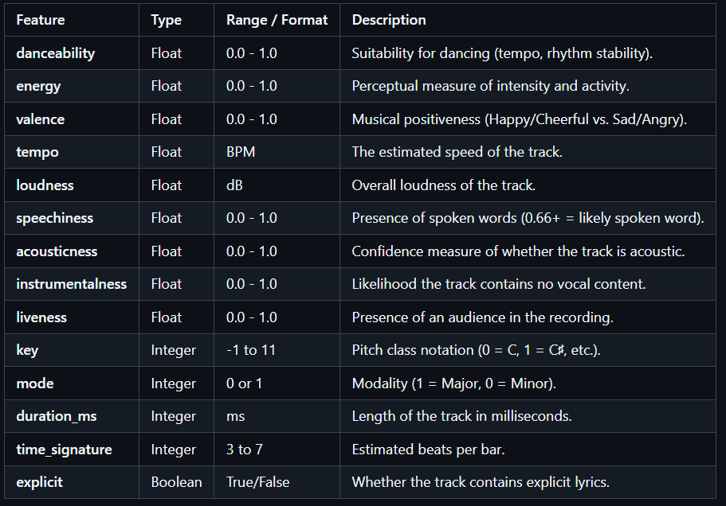
Data Strategy : EDA
Audio features :
Different scales : 0-1, integer, ms, True/False, BPM and dB.
9

Slide 10
Data Strategy : EDA
Target variable :
Initial target variable : Popularity (0-100).
2 factors : total number of streams and how recent those streams are.
New target variable : Hit (0-1).
Threshold at 65 : 8.31% hit (9477).
Missing values :
1 observation with 3 missing variables : artists, album_name and track_name.
10

Slide 11
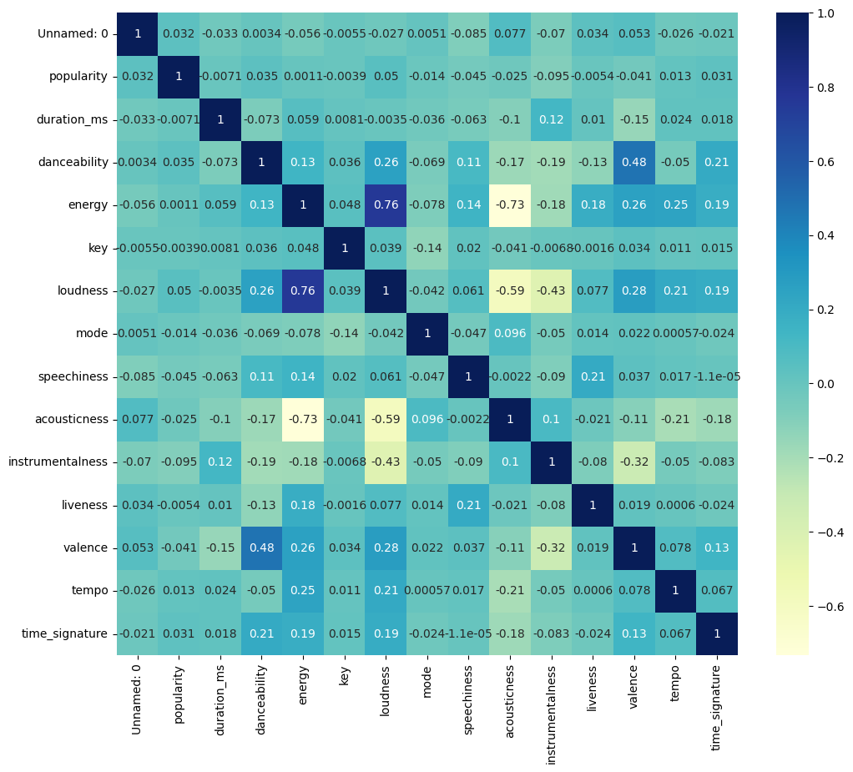
Data Strategy : EDA
Correlation matrix :
Highest positive correlation: 0.76 between loudness and energy.
Highest negative correlation: - 0.73 between energy and acousticness.
Popularity does not show strong correlation => non-linear model.
11

Slide 12
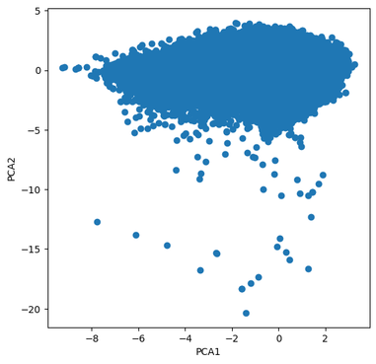
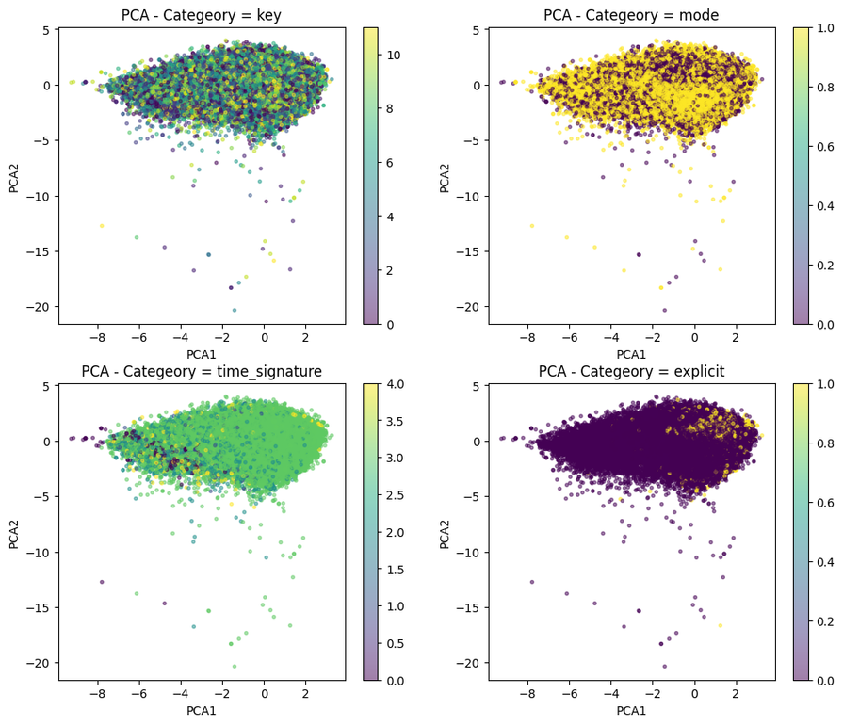
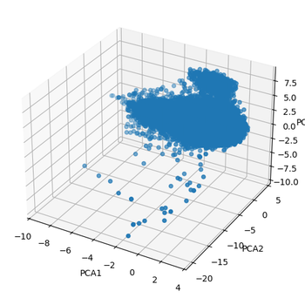
Data Strategy : EDA
PCA :
Explained variances:
PC1 : 28%, PC2 : 15% and
PC3 : 12%
No clear cluster.
No clear distinction by the categorical variables.
Implication for ML modelling :
Strong imbalance (8.31 % of hit).
No clear cluster.
No linear trend.
12

Slide 13
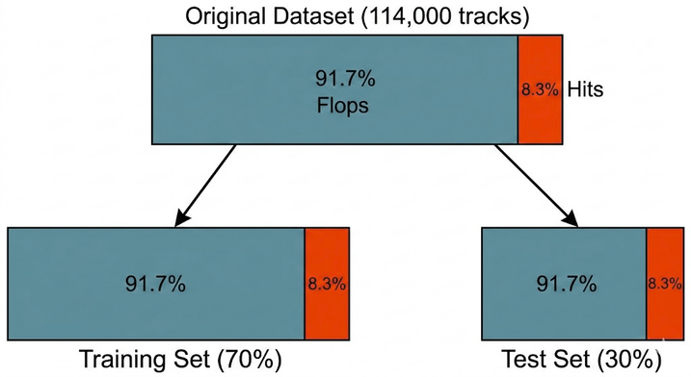
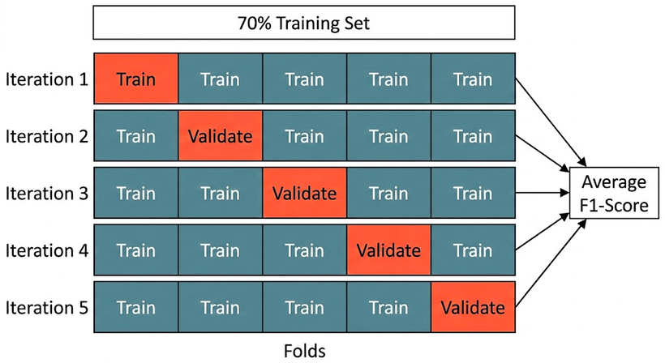
ML Models
The Goal: Classify Spotify tracks as "Hits" (Popularity over 65) vs. "Flops".
The Challenge: Extreme Class Imbalance (Only 8.31% Hits).
Experiment Setup:
Data Split: 70/30 Stratified Split .
Validation: Stratified K-Fold Cross-Validation (with shuffle).
Algorithms Tested: KNN, Random Forest, Gradient Boosting.
Decision Metric: F1-Score , Prioritized over Accuracy to handle the class imbalance.
13

Slide 14
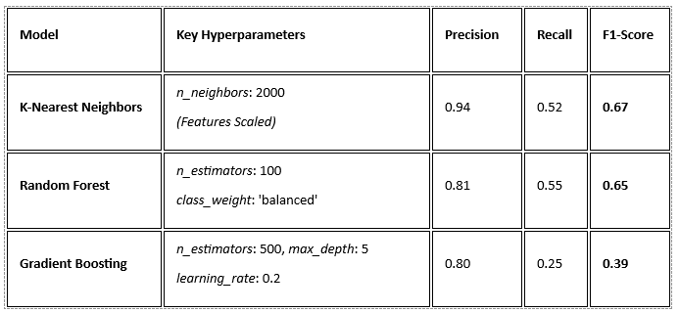
ML Models
Gradient Boosting struggled heavily (39%).
KNN achieved the highest overall score but required strict feature scaling.
Random Forest handled the imbalance naturally via class weights.
14

Slide 15
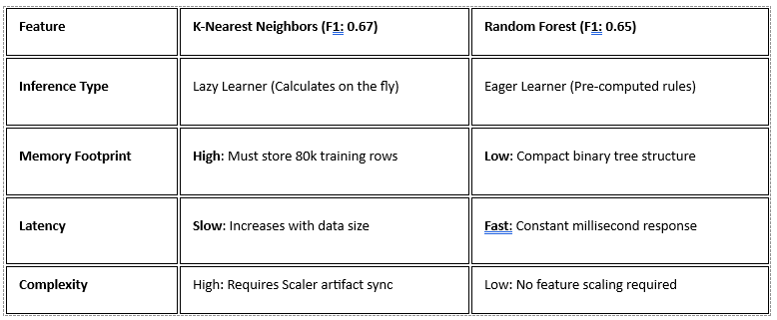
ML Models
We chose Random Forest for production. Despite KNN’s slightly higher F1-score, Random Forest is faster, uses less memory, and is more robust. It eliminates the need for feature scaling, significantly reducing technical debt and complexity for our MLOps pipeline.
15

Slide 16

Q & A

